Slide 1
Leading Your Security Teams in a Changing Environment
Barbara Stankowski
President/CEO/Owner

Slide 2
What is changing?
Globally
Technology
Economics
Threats
Privacy
Security
Unexpected Disaster (fire, hurricane, flood, etc.)
Organizationally
Technology
Security Arena impacting DSS and Defense contractors
Insider Threats
From JPAS to DISS
From eFCL and ISFD to NISS
NIST
Controlled Unclassified Information(CUI)
IT system cybersecurity
RMF – Classified Systems

Slide 3
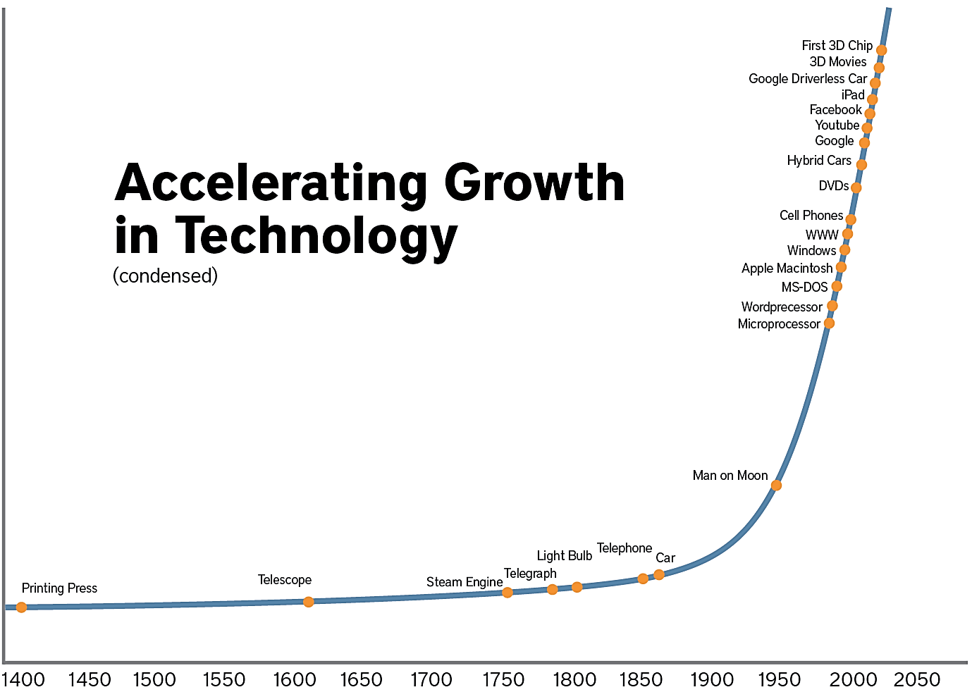
Notes:
Anyone in the business world – even casual observers of it – knows that it’s currently experiencing a rapid rate of change. New companies spring up seemingly overnight. Products and services that were revolutionary two years ago are rendered obsolete if they don’t adapt to market changes fast enough.
Most leaders have some level of recognition that they can’t keep doing things the same way if they want to prosper in this environment. But many have learned a method of approaching change (change management) that simply doesn’t work when the changes get too big and the environment moves too fast.

Slide 4
Change: Digital Transformation
Reshaping and changing everything:
Business
Communities
People
Nations
Notes:
Walmart Success to Amazon. Took Amazon 10% of Capitol and 10% of the time it took Walmart to reach the same level of success. Uber 1% of the capitol and 1% of the time

Slide 5
Change: Disaster Preparedness
Hurricane Irma
The U.S. Small Business Administration (SBA) approved 41,264 disaster loans for a total of $1.7 billion after Irma.
4,767 business disaster loans have been approved for $393 million.
Disaster Preparedness: After a Disaster (power outage, storm surge, fire)
40% of small businesses never reopen
70% did not have a disaster recovery plan
IT Security
68% of small businesses close down within 6 months after a cyber attack.

Slide 6
Change: What a Difference a Century Can Make
Characteristic
20th Century
21st Century
Organization | The Pyramid | The Web or Network
Focus | Internal | External
Style | Structured | Flexible
Source of Strength | Stability | Change
Structure | Self-sufficiency | Interdependencies
Resources | Atoms – Physical Assets | Bits – Information
Operations | Vertical Integration | Virtual Integration
Products | Mass Production | Mass Customization
Reach | Domestic | Global
Data: Business Week

Slide 7
Speed of Change Ever Increasing
The doubling of computer processing speed every 18 months, known as Moore's Law, is just one manifestation of the greater trend that all technological change occurs at an exponential rate.
Eighteen to twenty years out, technological innovation will be hundreds of thousands to a million times more advanced.
Three dimensional processors and memory drives along with biological, photon, and quantum computing will keep the rate of information improvement at an exponential pace.
As a leader of your organization:
Do you know what industries are headed for oblivion right now? Is yours?
Do you have the foresight that will keep you and your organization relevant in the next three to five years?
Notes:
– Energy – Solar power, which relies on nanotechnology, will be cheap enough and powerful enough to power the entire world within 20 years, says Kurzweil.Neuroscience
– Projects to reverse-engineer the brain will construct a full, synthetic model by 2029, says Kurzweil, giving us greater insight into how the brain thinks.Genetics
– Within 10 years we will all have digital copies of our genome, leading to medical therapies are personalized to our individual genetic makeup. –
Nanotechnology – As robots get smaller and smaller, we will be able to insert them into our bodies to repair damaged or aging tissue.
A 2013 Oxford University study concluded that in the U.S. about half of all jobs will disappear in the next 10 to 20 years, but that in less developed countries, job losses will be significantly worse. This latter group of observers of technological impact believe that job losses will be massive and permanent, eventually taking over even the highly skilled jobs that seem secure today.

Slide 8
Impact of Change
“Whenever human communities
are forced to adjust to shifting
conditions, pain is ever present.”
John P. Kotter
Leading Change, 1996

Slide 9
Creating a Corporate Culture for Change
General George Patton
“We have to be able to
change, or we will get the hell shot out of us. Nothing ever stays the same in war.”
Winston Churchill
“To improve is to
change,
to be perfect is to
change often.”

Slide 10
Change Impacts at a Personal and an Organizational Level
Personal Context:
Organizational Context:
New actions, policies, and
behaviors for the organization
Altering how we act, think, and feel as individuals

Slide 11
Phases of Change
Denial
Commitment
F
u
t
u
r
e
P
a
s
t
Resistance
Exploration
(Figure adapted from Elizabeth Kubler-Ross’ phases of coping)

Slide 12
The Leader’s Challenge
In today's complex global business environment, it's no longer enough to merely respond to change.
Successful leaders must be able to anticipate the impact of:
marketplace adjustments
new regulatory requirements
a change in business strategy
implementation of new technology within their organizations
The leader’s challenge is to develop a holistic approach to change:
to create an agile culture that embraces change
while promoting organizational resilience
Security needs to be an integrated component of the corporate culture
Notes:
How does this compare with our description earlier about an insider threat???

Slide 13
Transformational Change: An 8 Stage Process
Establish a sense of urgency.
Create the guiding coalition.
Develop a vision and strategy.
Communicate the change vision.
Empower broad-based action.
Generate short-term wins.
Consolidate gains and produce more change.
Anchor new approaches in culture.
John P. Kotter, Leading Change, pg. 21

Slide 14
Strategic Change Model
Strategic Phases
Tactical Phases
Assess
Establish Direction
Plan
Implement
Evaluate/ Institutionalize
Change Management Enterprise Team Support Available
Determine the Need for Change
Articulate the problem
Develop the Vision and Strategy
Image of future state
Alignment with strategic goals
Desired outcomes
Measures of success
Empower Broad-based Action
Execute plan, remove barriers to change (structural, skills, systems, behaviors)
Measure
Obtain Feedback
Assess progress
Develop Integrated Transition Plan
Vision/Strategy
Communications
Training
Human Resources
Metrics
BU/Site Transition Plans
Establish a Sense of Urgency
Consequences
Dealing with
complacency
Time sensitivity
Create a Guiding Coalition
Identify leaders with the power, expertise and credibility to drive change
Obtain leadership buy-in
Communicate the Change
Leadership by example
Repetition
Stories, metaphors
Multiple forums
Two-way communication
Refine and Stabilize Processes and Organization
Assess the Environment
Marketplace drivers
Culture/Values
Stakeholder needs
Potential impact(s)
on those affected
Perceptions/Priorities
Fallback
Socialize the Vision
and Outcomes
Gain feedback
Identify issues
Decision to move forward
Generate Short-Term Wins
Small Exploratory Group
(Consultant Support Available)
Design Team
Implementation Team
(organic support used)
Where are we
now?
Where do we
want to be?
How will we
get there?
Who must do
what?
How are we
doing?
* Incorporates “Eight-Stage Process of Creating Major Change” – John P. Kotter, Harvard Business School
Notes:
When we think about implementing change we need to first think about it as having two distinct phases -- a strategic phase where we explore and plan to take action and a tactical phase where we initiate, implement, and sustain the change.
Often in NAVAIR we acknowledge a symptom or a problem and begin taking action before we fully understand or get agreement from key stakeholders of the problem and intended solution. We tend to launch initiatives before we fully recognize what it is going to take to fully implement (resources, system changes, etc. -- then as we continue down the path we down-scope or shift the intent and in the end it is questionable whether we achieved the desired business results. This model promotes the use of rigor, involvement of key stakeholders, and firm commitment to achieve results before launching.
The first two steps - Assess and Establish Direction are critical -- they build the foundation of the entire change effort.
In the assess step -- we define and gain agreement of the problem we are trying to solve, why we need to solve it now, and what else is going on in the environment.
In establishing direction we define what success looks like and how we will measure success, what business results we want to achieve, which leaders are key to success -- they can make or break the effort, what is it really going to take to implement the vision. This is where we acknowledge the complexity of our organization - we are on the path to become one NAVAIR -- however, at this time we still have different organizational systems and cultures that are based primarily on geographic and legacy; there are also local leaders that must be engaged and have an opportunity to let the Command know what it will take for them to support and enable the change in their part of the organization.
During the plan step we are developing specific action plans to transition the organization from the current stage to the future state. The transition plans generally will be a Command level with specific plans for local actions, when appropriate.
In Implement we are executing the action plans, engaging more people in the implementation, leaders at many levels are involved in changing the system and readying the workforce for the change. Along the way we celebrate and recognize short term wins and build upon those. Plans are adjusted along the way as those leading the change learn more about the environment and the issues that are surfacing.
The last step is to evaluate and institutionalize. This is to assure that we have achieved the business results and that the change is a part of normal every day life in NAVAIR. The change should be integrated and sustained into an organic function in the organization.

Slide 15
Leader’s Role in Change
No longer dealing with one organizational or several changes at a time
Instead must be focused on developing a culture that embraces change/disruption with not just the leader but a large numbers of leaders throughout the organization who embrace:
An accelerated sense of urgency
Rapid adoption of technology shifts
Agility so the organization adapt quickly
Just-in-time decision making
Thinking out of the box
Rapid implementation and elimination of road blocks
A compelling vision of the future that incorporates ever accelerating change and disruption
Notes:
And learning the new methodology, which is not just a managerial-driven methodology associated with planning and organizing and budgeting, etcetera, but it is much more a leadership-driven methodology, which we have found fundamentally plays itself out in eight phases, having to do with pushing urgency up and getting a huge team of people that want to drive change, and figuring out the vision and the strategic initiatives, and communicating that out and getting buy-in, and as more and more people start to act, make sure that the barriers that block action are gotten out of the way, that's empowerment, make sure you get short-term wins that are visible so people continue to work and it gives you credibility. Working, working, working—never letting up until the vision becomes a reality, and even then, institutionalizing it ultimately into the culture. That is not what we've been taught to do; it's not what organizations do. They're going to have to learn to do it.
There is no longer time to “predict the future” and, anyway, the future was too uncertain. Now, quick adaptation and decisions were needed. Amazingly, some companies had even created “situation rooms” to monitor current events to support quicker decisions.
Companies that do the same old things, make only incremental changes, and demonstrate “me-too” thinking will get left behind in today’s rapidly changing, hyper-competitive, disruptive world.

Slide 16
It Starts with the Leader:
Modeling the way by embracing change and not being a roadblock to change
Encouraging the heart
Inspiring a shared vision of an agile, responsive corporate culture
Constantly challenging the current process, the “we have always done it this way”
Enabling others to act; leadership at all levels of the organization
The Leadership Challenge
Kouzes and Posner
Notes:
Companies that do the same old things, make only incremental changes, and demonstrate “me-too” thinking will get left behind in today’s rapidly changing, hyper-competitive, disruptive world.

Slide 17
Questions??

